Slide 1
Pain Management
Adapted from the National Pediatric Nighttime Curriculum: Nicole D. Marsico, MD
(Stanford University School of Medicine)
Please view in presentation mode for best experience
Updated 06/2020 MZ

Slide 2
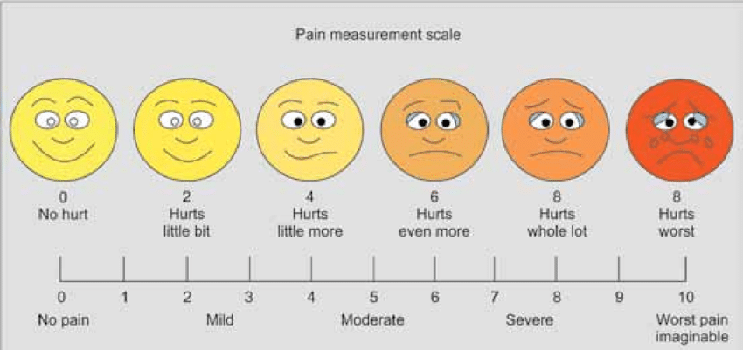
Case 1
A 4 year old has recently returned from having an abscess drained and has a JP drain in place. The nurse is asking for pain medication.
DISCUSSION: How would you assess the patient’s pain?
Vital signs (high BP, Tachycardia can indicate pain), non-verbal cues, ask them/ parent, FACES scale
Notes:
-Pain can be assessed in this child by asking questions and using a scale with different faces rather than numbers. Non-verbal cues and parental report may also be helpful.
-It may be helpful to start with an around the clock medication like acetaminophen with an opiate available as needed.
-If the patient is in continued pain, you may decide to make the opiate scheduled (i.e. morphine q4). The goal is to continually reassess the patient’s pain, what is working and what is not.

Slide 3
Case 1 continued
DISCUSSION: What pain medication should you start with?
Order different options for different levels of pain (ex. moderate pain, severe pain)
Can consider scheduling a non-opiate and having a breakthrough opiate. (ex. Tylenol scheduled and morphine for breakthrough)
Be careful if using a combo medicine (ex. Lortab) not to exceed daily limit of Tylenol
Continue to reassess pain

Slide 4
Case 1 continued
Continue to reassess and trouble shoot
Pain medication not lasting long enough (getting severe pain before next dose is due)- make breakthrough more frequent with smaller dose
Medication not treating pain adequately- consider larger dose less frequently

Slide 5
Case 2
A 10 yo female with a fractured arm is complaining of pruritus with morphine.
How would you assess her pain?
For older patients, can use numerical score (0-10)
What changes would you make to her pain regimen?
Can consider non-opiate alternative such as ibuprofen or tylenol, if mild-moderate pain
Can try diphenhydramine
Consider other opiates
Notes:
A 10 year old can better verbalize her pain and a numerical pain score can be used.
Trying another opiate would be an appropriate change to her regimen.

Slide 6
Objectives
Understand the different types of pain
Know how to initiate pain medications
Learn to assess pain and modify treatment strategies

Slide 7
Types of Pain
DISCUSSION: What are some types of pain?
Nociceptive
Somatic
Well-localized, sharp
Pain receptors in soft tissue, skin, skeletal muscle, bone
Visceral
Vague
Visceral organs (ex. Kidney, liver)
Neuropathic
Burning, shooting, tingling
Damaged sensory nerves (transection, compression)

Slide 8
Pain Management
Pediatricians often under-treat children’s pain
A study of 223 hospitalized patients, 20% had clinically significant pain. (Ellis et al. 2002)
Has the patient had pain medications before? What worked?
Patients with chronic pain may require higher doses due to tolerance

Slide 9
Assessing Pain
Infants
Face, Legs, Activity, Cry, Consolability (FLACC)
Verbal Children
Scale of 1-10 (may use faces and/or numbers)
Non-verbal clues
Notes:
-Infant pain can be assessed by scoring their behavior.
-Older children can rate their own pain using numbers or faces.
*Also use non-verbal clues to get a better idea of pain such as heart rate, facial expressions, activity
*Keep in mind that some children may also minimize pain. They may feel they have to “be brave”, are scared of taking medications, or scared that taking medications will prolong their hospital stay.
9

Slide 10
FLACC
 | 0 | 1 | 2
FACE | No particular expression or smile | Occasional grimace or frown, withdrawn, disinterested | Frequent to constant quivering chin, clenched jaw
LEGS | Normal position or relaxed | Uneasy, restless, tense | Kicking or legs drawn up
ACTIVITY | Lying quietly, normal position, moves easily | Squirming, shifting back and forth, tense | Arched, rigid, or jerking
CRY | No cry | Moans or whimpers, occasional complaints | Crying steadily, screams or sobs
CONSOLABILITY | Content, relaxed | Reassured by touching, hugging, voice, distraction | Difficult to console or comfort
Notes:
This is the FLACC score used to assess pain in infants. It places the pain on a score of 0-10.

Slide 11
Non-pharmacologic Pain Management
Physical
Massage
Heat (k-pad) and cold (ice packs)
Acupuncture
Behavioral
Relaxation
Art and play therapy (child life)
Music therapy
Biofeedback
Cognitive
Distraction
Imagery and Hypnosis
Notes:
Non-pharmacologic interventions may be helpful in managing pediatric pain and decreasing medical use. However, many of these services are not available in the middle of the night. These strategies would be important to recommend to the day-time medical team.

Slide 12
Pain Medications
Acetaminophen
PO: 10-15 mg/kg every 4-6 hours
PR: Loading dose 35-50 mg/kg; Maintenance dose 20 mg/kg every 6 hours
IV: Omfirev
NO MORE THAN 5 DOSES in 24 hours
Ibuprofen
PO: 5-10 mg/kg every 6-8 hours
MAX 40 mg/kg/day
Contraindicated in active GI bleeding, hypersensitivity to NSAIDs, renal insufficiency
Caution in severe asthmatics

Slide 13
Pain Medications
Ketorolac
NSAID
Available PO, IV, IM
Potential opioid sparing effect
Concern regarding bleeding post-operative
Cannot be used for a long time
Avoid with renal acute kidney injury/insufficiency/failure
Max use of 5 days

Slide 14
Pain Medications
Morphine
Start with a low dose and titrate carefully for effect
IV: 0.05-0.1 mg/kg every 2-4 hours
PCA can be used in severe/ constant pain if above is not effective
Initiate bowel regimen due to constipating effect
Be cognizant that it can cause respiratory depression
Reduce dose in renal impairment
Notes:
-Opiates are an effective class of pain medicines. Patients who have side effects (i.e. itching, nausea, sleepiness) with one opiate may not have it with another.
-Codeine
*Metabolized to morphine in the liver (Cytochrome P-450 2D6)
*Some people are poor metabolizers leading to NO analgesic effect
* Other are ultra-rapid metabolizers (40% of people of North African descent), causing morphine accumulation and death. (Kraemer 2009, Ciszkowski and Madadi, 2009)
-Morphine
*Oral and parenteral forms
*Avoid or reduce dose in renal impairment
*Consider a PCA in patients with constant pain. PCAs can help to actually lower the total daily dose of medication
-As opiates are known to cause constipation, it is also preferable to start patients on a bowel regimen when initiating opiate therapy.

Slide 15
Pain Medications
Oxycodone
4-5 hour duration
Fentanyl
Potent (100x morphine), short duration
Transdermal patch has long onset and long acting (2-3 days)
Hydromorphone
5x more potent than morphine
4-6 hour duration

Slide 16
Pre-procedural topical anesthesia
EMLA (Lidocaine and Prilocaine)
Can be used prior to painful procedures such as lumbar puncture or IV access
Apply ideally 1 hour before procedure. Once cream is rubbed off, it is effective for approximately 2 hours

Slide 17
Take Home Points
Assess pain using an age appropriate tool.
Consider starting an around the clock regimen.
Continually assess pain and modify medication regimen appropriately.
Notes:
17

Slide 18
Take Home Points
When to call the attending:
Patient has persistent or worsening pain despite appropriate analgesic regimen.
When to transfer to a higher level of care:
Patient develops respiratory depression with opiates
Control airway and ventilation
Order opioid antagonist (Naloxone) while calling for help
Notes:
18

Slide 19
Recommended reading
Kraemer FW, Rose JB. Pharmacologic management of acute pediatric pain. Anesthesiology Clin. 2009; 27:241-268.
https://www.clinicalkey.com/#!/content/playContent/1-s2.0-S1932227509000421?returnurl=https:%2F%2Flinkinghub.elsevier.com%2Fretrieve%2Fpii%2FS1932227509000421%3Fshowall%3Dtrue&referrer=https:%2F%2Fpubmed.ncbi.nlm.nih.gov%2F19703675%2F

Slide 20
References
Berde CB, Sethna NF. Analgesics for the treatment of pain in children. N Engl J Med. 2002; 347: 1094-1103.
Ciszkowski C, Madadi P. Codeine, ultrarapid-metabolism genotype, and postoperative death. N Engl J Med. 2009; 361: 827-828.
Ellis JA, O’Connor BV, Cappelli M, Goodman JT, Blouin R, Reid CW. Pain in hospitalized pediatric patients: how are we doing? Clin J Pain. 2002; 18:262-269.
Howard, RF. Current status of pain management in children. JAMA. 2003; 2464-2469.
Kraemer FW, Rose JB. Pharmacologic management of acute pediatric pain. Anesthesiology Clin. 2009; 27:241-268.
World Health Organization. Cancer pain relief and palliative care in children. Geneva: 1998. Accessed via: http://www.stoppain.org/for_professionals/cancerbk.pdf

