Slide 1
Altered Mental Status
Adapted from the APPD National Pediatric Nighttime Curriculum,
Terry Platchek, MD (Lucile Packard Children’s Hospital, Stanford University)
Please view in presentation mode to facilitate discussion
MZ updated 06-2020

Slide 2

Objectives
Recognize lethargy/ altered mental status
Understand major causes in change in mental status
Initiate workup and management

Slide 3
Definitions
Confusion, lethargy/obtunded, stupor: decreased consciousness and decreased response to stimulation with differing degrees. Awareness is affected first due to its more widely distributed cortical network
Confusion: difficult to follow commands, unaware of surroundings
Lethargy/ Obtunded: severe drowsiness, moderate stimuli to arouse
Stupor: takes vigorous stimuli to arouse individual
Coma: unarousable unconsciousness

Slide 4
Case 1
Amaya is a 13 year old presenting to the ER. Family notes that she hasn’t been acting herself since they picked her up from a friend’s house this afternoon. She has started vomiting and is not responding to her family’s questions.
DISCUSSION: What are some categories/ causes of altered mental status?

Slide 5
Differential is broad

Slide 6
Broad differential: Mnemonic AEIOU TIPS

Slide 7
Case Continued
DISCUSSION: What other information would you want to know?
  Any medications in the friend’s home?
  Any potential poisons?
  What is the time frame?
  Accidental or intentional?
  Any witness to initial insult?
  Any recent illness/ fevers?
  Any other abnormalities (not moving extremities)
  Any trauma?
  Family history of coagulopathies?

Slide 8
Mnemonic: AMPLE History
A: Allergy/Airway
M: Medications
P: Past medical history
L: Last meal
E: Event - What happened?
  Rapid or Gradual Onset?
  Preceding Headache or Neurologic Symptoms?
  Ingestions?
  Vague or inconsistent history from caregiver is suspicious for non-accidental trauma.

Slide 9
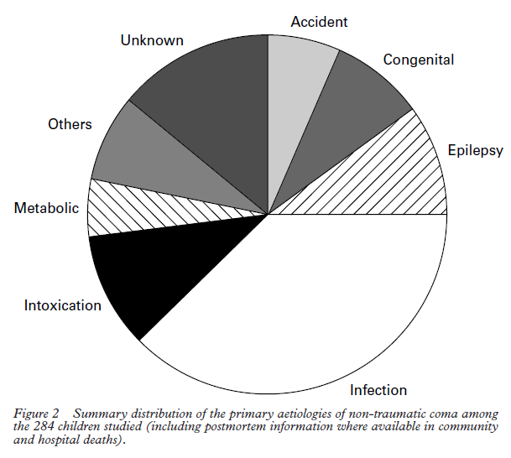
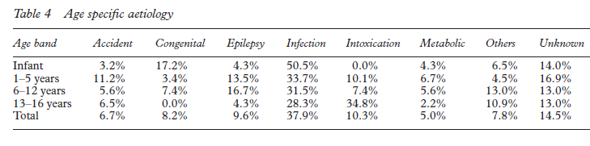
Etiology of non-traumatic pediatric coma
9.6%
10.3%
37.9 %
From: C P Wong, R J Forsyth, T P Kelly, J A Eyre. Incidence, aetiology, and outcome of
non-traumatic coma: a population based study. Arch Dis Child 2001;84:193–199
Infection is the leading cause
Intoxication is increased during adolescence
Epilepsy has highest incidence in preschool and school age years

Slide 10
Case 2
Jordan is a 5 year old who is admitted for gastroenteritis. He was given an IV normal saline bolus in the ER and Ondansetron and admitted to general pediatrics for further management. He has two episodes of emesis and an episode of diarrhea upon admission to the floor. When you arrive to examine him, he is noted to be lethargic.
DISCUSSION QUESTION: What are two likely causes of his lethargy based on the history?
  Hypoglycemia or dehydration/ metabolic abnormality, sepsis
  Obtain a BMP, assess hydration status, and give dextrose/ fluids as indicted
DISCUSSION QUESTION : What are some important aspects of the physical exam.

Slide 11
Evaluation of Altered Mental Status
(Michaelson et. al)
Physical exam:
Focused exam to narrow the differential
Airway, breathing, circulation and vital signs
Neurologic exam: level of consciousness/ responsiveness, motor response, brainstem reflexes
Meningeal signs: nuchal rigidity
Brudzinski’s sign: Involuntary hip and knee flexion with forced neck flexion
Eye exam:
Pupillary response (blown pupil can be sign of herniation)
Papilledema (increased ICP for several hours)
Retinal hemorrhage (sign of abusive trauma)
Skin
Bruising or rashes concerning for trauma or infection
Kernig’s sign: Involuntary knee flexion with forced hip flexion
Sundowning (can be sign of increased intracranial pressure)

Slide 12
Glasgow Coma Scale
DISCUSSION QUESTION: What are the domains of the Glasgow Coma Scale?
  Eyes
  Verbal
  Motor

Slide 13
Pediatric Glasgow Coma Scale
 | Infant < 1 yr | Child 1-4 yrs | > 4 years
EYES
4 | Open | Open | Open
3 | To voice | To voice | To voice
2 | To pain | To pain | To pain
1 | No response | No response | No response
VERBAL
5 | Coos, babbles | Oriented, speaks, interacts, social | Oriented and Alert
4 | Irritable cry, consolable | Confused speech, disoriented, consolable | Disoriented
3 | Cries persistently to pain | Inappropriate words, inconsolable | Nonsensical speech
2 | Moans to pain | Incomprehensible, agitated | Moans, unintelligible
1 | No response | No response | No response
MOTOR
6 | Normal spontaneous movement | Normal spontaneous movement | Follows commands
5 | Withdraws to touch | Localizes pain | Localizes pain
4 | Withdraws to pain | Withdraws to pain | Withdraws to pain
3 | Decorticate flexion | Decorticate flexion | Decorticate flexion
2 | Decerebrate extension | Decerebrate extension | Decerebrate extension
1 | No response | No response | No response
Notes:
Total of 15 points which is considered normal. The minimum score is 3.
In patients with a glascow coma score of ≤ 8 intubation is recommended as these patients are at high risk for not protecting their airway.

Slide 14
Management (adapted from Thompson and Williams)
Airway, Breathing, Circulation
Intubation for GCS ≤ 8 for airway protection
Treat underlying cause!!
Hypoglycemia: Dextrose Fluids (D10 IV; 2.5ml/kg)
Seizures: Lorazepam (0.1mg/kg for clinical seizures)
Ingestion: Antidote or reversal
Infection: Ceftriaxone, Vancomycin, Acyclovir
Increased ICP: Mannitol 1g/kg or hypertonic saline

Slide 15
Diagnostic Studies
CT: evaluate intracranial bleeding, trauma, mass, and evidence of increased ICP
Lumbar puncture: after increased ICP ruled out
EEG: to rule out sublinical seizure
Labwork: CMP, CBC, urine drug screen, Tylenol level, salicylate level, ammonia, lactic acid, blood cultures (based on clinical history)

Slide 16

Case 3
16 year old brought in unconscious by friends from a party. Physical exam notes smell of alcohol, HR 178, fever to 39.8, diaphoresis, BP 185/107. What is the most likely etiology?
  MDMA/ Amphetamine intoxication
    Supportive care, complications include DIC, hyperthermia, rhabdomyolysis,
What if the patient has absent sweating and dilated pupils?
  Anticholinergic intoxication
    Obtain EKG. At risk for QRS prolongation. Treat with sodium bicarb.
    Antidote is physostigmine
This Photo by Unknown Author is licensed under CC BY-NC

Slide 17
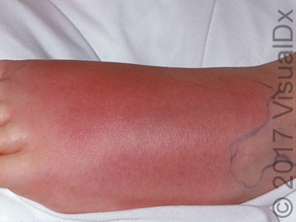
Case 4: It’s 3 am
3 year old with history of OTC deficiency admitted for cellulitis. Found unresponsive in his room. DISCUSSION: What is your differential and workup?
Differential: hyperammonemia, hypoglycemia, sepsis, ingestion, trauma, or sub-clinical seizure.
Workup: focused physical exam, ammonia, glucose, CMP, CBC, blood cultures.
https://www.visualdx.com/visualdx-blog/cellulitis-and-its-mimickers

Slide 18
Supplemental Reading
Altered States of Consciousness: Pediatrics in Review 2006
https://pedsinreview.aappublications.org/content/27/9/331

Slide 19
References
Berger, Joseph R. Clinical Approach to Stupor and Coma. In: Neurology in Clinical Practice: Principles of diagnosis and Management, 4th ed, Bradley, WG, Daroff, RB, Fenichel, GM, Jankovic, J (Eds), Butterworth Heinmann, Philadelphia, PA 2004. p.46.
C P Wong, R J Forsyth, T P Kelly, J A Eyre. Incidence, aetiology, and outcome of non-traumatic coma: a population based study. Arch Dis Child 2001;84:193–199
Michelson D, Thompson L, Williams E. Evaluation of stupor and coma in children. UpToDate. 2006.
Simpson D, Reilly P. Pediatric coma scale. Lancet 1982; 2:450.
Teasdale G, Jennett B. Assessment of coma and impaired consciousness. A practical scale. Lancet 1974,2:81-84 [Glasgow Coma Scale]
Tindall SC. Level of Consciousness. In: Walker HK, Hall WD, Hurst JW, editors. Clinical Methods: The History, Physical, and Laboratory Examinations. 3rd edition. Boston: Butterworths; 1990. Chapter 57. Available from: https://www.ncbi.nlm.nih.gov/books/NBK380/
Thompson L, Williams E. Treatment and Prognosis of Coma in Children. UpToDate. 2010.

