Slide 1
Bradycardia
Adapted from the National Pediatric Nighttime Curriculum: Jennifer Everhart, MD (Lucile Packard Children’s Hospital)
For best experience, use presentation mode
Updated 06/2020 MZ

Slide 2
Learning Objectives
Recognize common pediatric cardiac bradyarrhythmias
Appreciate the clinical significance of bradycardia
Initiate management of bradyarrhythmias in the inpatient setting

Slide 3
Case 1
The nurse calls you about Devon, a 15 year old male admitted for joint pain who’s heart rate is 55.
DISCUSSION: What is your differential, list 4 causes?
See next slide

Slide 4
Causes of Bradycardia
Sinus bradycardia from decreased metabolic demand during sleep
Sinus bradycardia due to athletic conditioning
Medications (ex. Narcotic analgesics)
Underlying heart block (1st degree and Mobits Type 2 second degree)
Rheumatic heart disease leading to PR prolongation (1st degree block)

Slide 5
Case #1
EKG obtained. Patient is talking to you telling you about his basketball tournament next weekend.
.
DISCUSSION: What does the EKG show?
Sinus bradycardia
DISCUSSION: Since heart rate is <60, would you start chest compressions?
No, if patient has good perfusion even though heart rate is less than 60 no need for compressions
Thaler 2003

Slide 6
Bradyarrhythmias - Symptoms
Symptoms:
General: altered LOC, fatigue, lightheadedness, dizziness, syncope
Hemodynamic instability: hypotension, poor end-organ perfusion, respiratory distress/failure, sudden collapse

Slide 7
Bradyarrhythmias - Causes
General causes:
1º: Abnormal pacemaker/conduction system (congenital or postsurgical injury), cardiomyopathy, myocarditis
2º: Reversible Hs & Ts:
– Hypoxia – Hypotension – Heart block – H⁺ ions (acidosis) – Hypothermia – Hyperkalemia
– Trauma (head)
– Toxins/drugs (cholinesterase inhibitors, Ca⁺⁺
channel blockers, β-adrenergic blockers, digoxin,
central α₂ adrenergic agonists, opioids)

Slide 8
Case #2
A 7 year old boy, Jimmy, with a history of neonatal intraventricular hemorrhage underwent a ventriculoperitoneal shunt revision today. Nurse calls to tell you he is having heart rates down to the 50’s. Read the following EKG.
Teaching file – Courtesy of Wilson King, MD

Slide 9
Case 2 continued
Reading the EKG:
Rate: 50-60 – Bradycardic
Rhythm: P before every QRS – Sinus
Rhythm variable: Yes – Sinus Arrhythmia
Interval: Narrow QRS, Normal PR interval
Diagnosis: Sinus bradycardia with sinus arrhythmia
Assess patient. If having impaired breathing, hypertension, mental status change, may have increased ICP requiring immediate intervention.

Slide 10
Sinus Bradycardia
Can be a physiologic consequence of decreased metabolic demand (ie: while sleeping) or increased stroke volume (ie: athletes)
Other potential causes include:
Endocrine: hypothyroidism, hypoglycemia
Neurologic: seizures or head trauma causing increased vagal tone; ↑ICP
Ingestion: Beta-blockers, Ca⁺⁺ channel blockers, digoxin, antiarrhythmics
Hypothermia
Infectious: Sepsis
Sinus bradycardia is rarely primarily cardiac in pediatrics.

Slide 11
Case #3
A 4 month old boy was transferred from the CVICU earlier in the day, following an uncomplicated repair of his VSD. His nurse notifies you that his rhythm on the cardiac monitor looks odd.
What do you think is going on?
What is the first thing you would assess in your evaluation of this patient?
What work-up would you do?
How would you treat this child?
Yanowitz, 2006
Notes:
Teacher’s guide:
This patient has 3rd degree (complete) AV block, likely as a result of surgical interruption of his conduction pathway during his VSD repair.
Management:
Assess hemodynamic stability and ABCs.
Assuming the patient is stable and well-perfused, the next steps would be to obtain a 12 lead EKG and contact the cardiologist on-call.
The patient should be continued on cardiac monitoring/telemetry
Consider notifying (or transferring to) PICU
When discussing this case, consider highlighting:
EKG differences between sinus bradycardia & 1st, 2nd, 3rd degree AV block
The varying clinical significance of AV blocks (ie: 1st and 2nd degree Mobitz Type I are often not clinically significant, but 2nd degree Mobitz Type II can be more symptomatic, and 3rd degree can progress to ventricular fibrillation and usually requires a pacemaker)

Slide 12
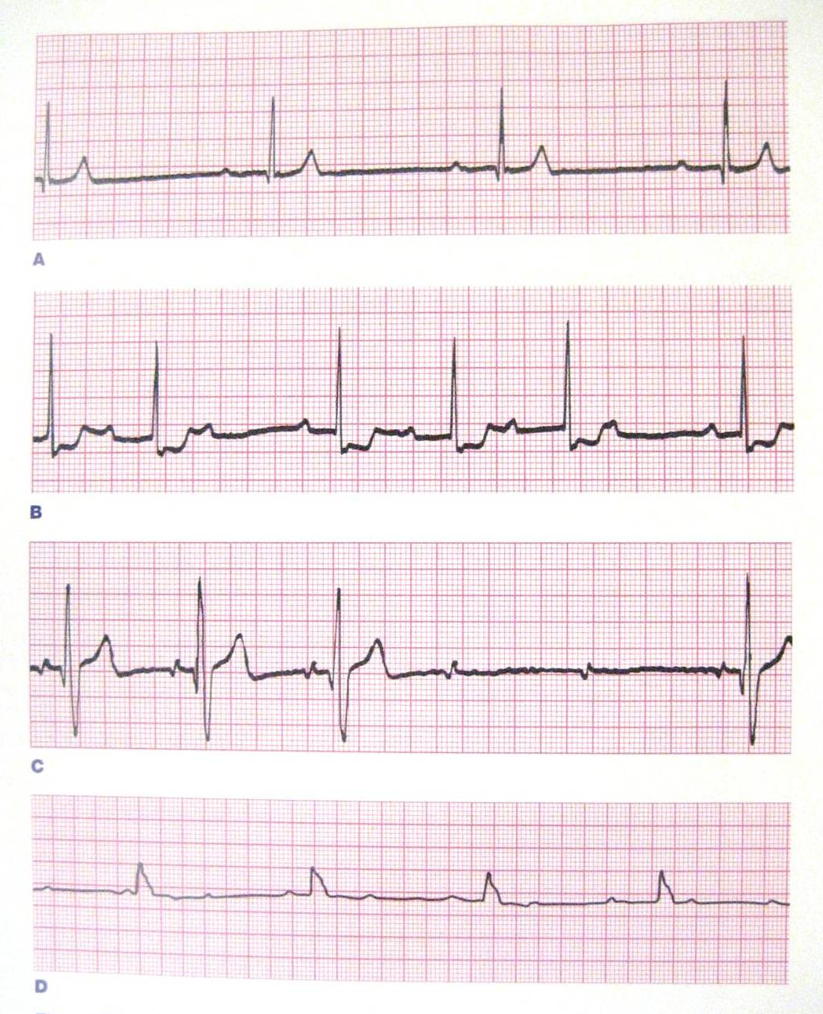
AV Blocks
1st degree heart block: PR prolongation (>0.1-0.15 sec). No dropped QRS.
2nd degree heart block, Mobitz I (Wenckebach): Progressive prolongation of PR until 4th P wave is not followed by QRS
2nd degree heart block, Mobitz II: Consistently prolonged PR with 4th and 5th waves not followed by QRS
3rd degree heart block: No relationship between P waves and QRS complexes (AV dissociation)
Ralston et al, 2006
Notes:
Teacher’s guide:
A. Prolonged PR of 8 mm (320 ms), no dropped QRSs -> 1st degree
B. Progressive prolongation of PR until 4th P wave is not followed by a QRS (ie: 3rd and 7th QRSs are dropped in figure above) -> 2nd degree Mobitz type I
C. Consistently prolonged PR of 5 mm (200 ms); 4th and 5th P waves above are not followed by QRS -> 2nd degree Mobitz type II
D. No relationship between P waves & QRS complexes -> 3rd degree

Slide 13
AV Blocks
Type | EKG Findings | Causes & Clinical Significance
1st Degree | Prolonged PR interval | Causes include AV nodal disease, ↑vagal tone, myocarditis, abn electrolytes (ie: ↑K⁺), MI, drugs (ie: Ca⁺⁺ channel blockers, β-blockers, digoxin), acute rheumatic fever. Usually asymptomatic.
2nd Degree Mobitz type I Wenchebach | Progressive prolongation of PR interval until atrial impulse not conducted to ventricles | Usually due to block within AV node. Caused by ↑parasympathetic tone, MI, drugs (ie: Ca⁺⁺ channel blockers, β-blockers, digoxin). Can cause dizziness. Typically transient and benign; rarely progresses to 3rd degree heart block.
2nd Degree Mobitz type II | Constant prolongation of PR interval, inhibition of a set proportion of atrial impulses | Usually caused by defect in conduction pathway or acute coronary syndrome, leading to block below AV node & His bundle. Symptoms include palpitations, presyncope, syncope. Can progress to 3rd degree heart block; often requires pacemaker.
3rd Degree Complete | AV dissociation. No atrial impulses are conducted to the ventricle | Congenital or caused by conduction system disease or injury (ie: surgery, MI). Most symptomatic form of heart block: fatigue, presyncope, syncope. Usually requires pacemaker (especially if acquired).
Notes:
Teacher’s guide:
AV block rhythms are caused by a disturbance of electrical conduction through the AV node:
Normal PR = 3-4 mm (generally 0.1-0.15 sec, depending on age)
1st degree
Prolonged PR interval
2nd degree, Mobitz type I/Wenchebach phenomenon
Progressive prolongation of the PR interval until an atrial impulse is not conducted to the ventricles
Ie: one P not followed by QRS
2nd degree, Mobitz type II
Constant prolongation of PR interval, consistent inhibition of a set proportion of atrial impulses
Usually 2:1 atrial to ventricular rate
3rd degree, “complete”
None of the atrial impulses are conducted to the ventricle
Ie: no relationship between P waves & QRS complex

Slide 14
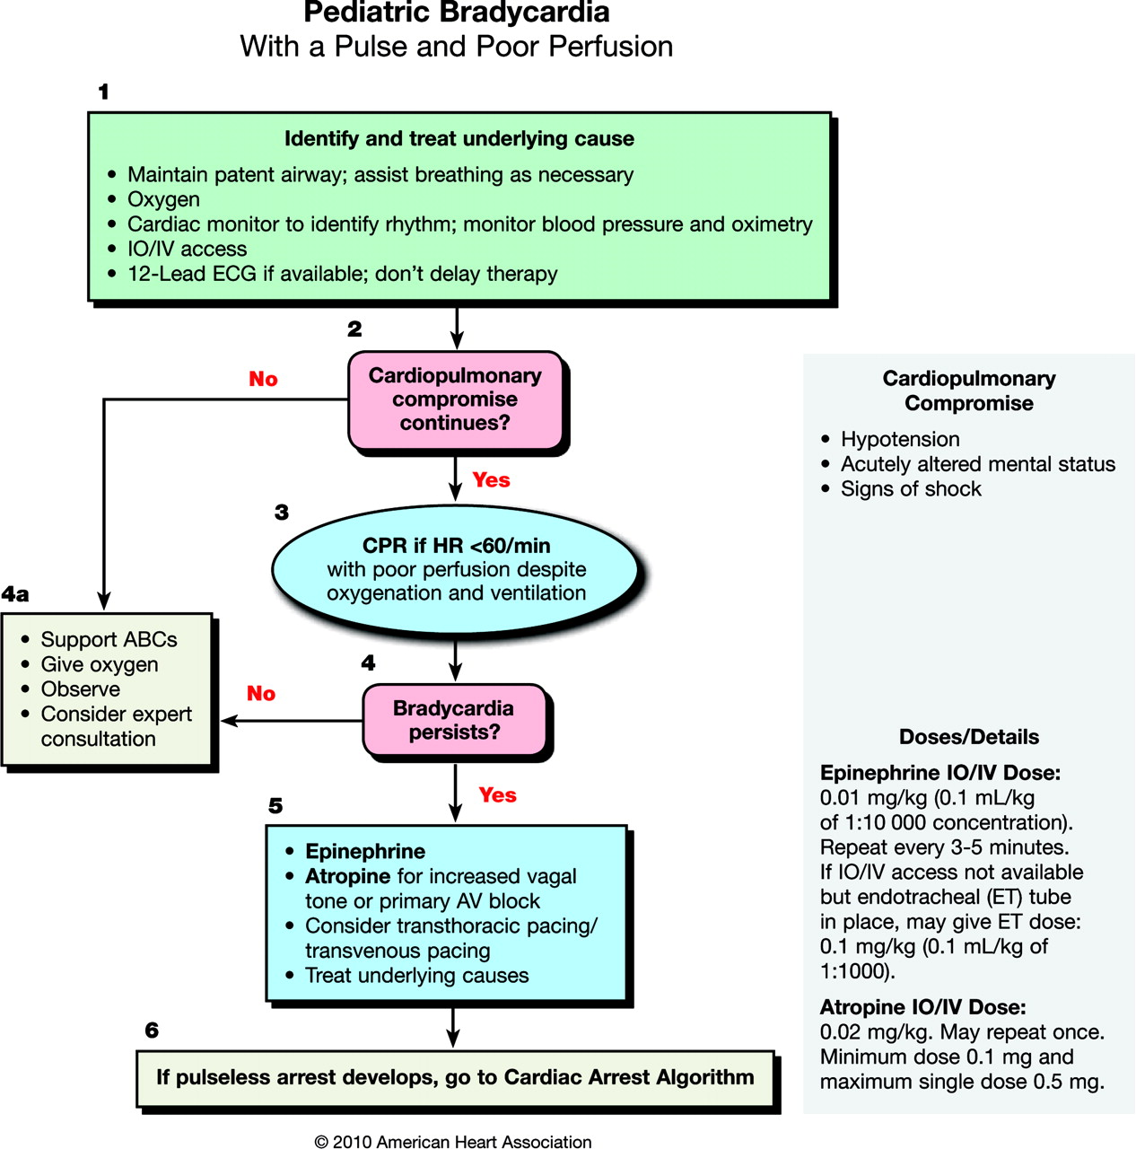
Bradyarrhythmias – Management
Stable patients:
12 lead EKG
Consult cardiology
Unstable patients:
ABCs
PALS Pediatric Bradycardia Algorithm
Address reversible causes (Hs & Ts)
Consider labs
Ie: blood gas, chemistry panel, digoxin level if applicable
Kleinman et al 2010
Notes:
Teacher’s guide:
PALS algorithm is included for reference – please note that this presentation is not meant to be thorough review of PALS.
Additional interventions:
Consider pacing if persistently bradycardic despite above interventions
Consider epinephrine drip (0.1-0.3 µg/kg/min) or dopamine drip (2-20 µg/kg/min) & titrate to response

Slide 15
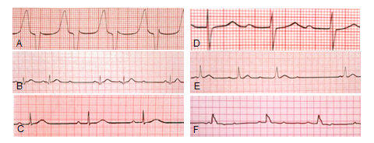
EKG review
Identify the following rhythms:

Slide 16
EKG answers
A. Idioventricular escape rhythm (sinus node block)
B. Mobitz type II 2nd degree AV block
C. 1st degree AV block
D. Sinus bradycardia
E. Mobitz type I 2nd degree AV block (Wenckebach)
F. 3rd degree heart block

Slide 17
Take home points
When evaluating a patient with a bradyarrhythmia, the first step is always to address clinical/hemodynamic stability: airway, breathing, circulation. Further management is guided by the PALS Pediatric Bradycardia Algorithm.
Sinus bradycardia is rarely due to primary cardiac pathology in children – reversible causes should be sought and addressed.
Atrial, junctional, and idioventricular escape rhythms are the result of subsidiary pacemakers initiating depolarization in the event of sinus node failure.
1st, 2nd, and 3rd degree AV blocks vary in etiology and clinical significance. 1st degree and 2nd degree Mobitz Type I are often minimally symptomatic and even self-resolving. 2nd degree Mobitz Type II is more symptomatic, can progress to 3rd degree, and may require pacemaker. 3rd degree is the most symptomatic, and usually requires pacemaker.

Slide 18
References
Key References for independent study:
Kleinman ME, et al. Part 14: Pediatric Advanced Life Support: 2010 American Heart Association Guidelines for Cardiopulmonary Resuscitation and Emergency Cardiovascular Care. Circulation 2010;122;S876-S908.
Ralston M, et al. PALS Provider Manual. American Heart Association, 2006.
Additional References used to prepare this presentation:
12 Lead EKG Interpretation Part #2, nursingpub.com.
American Heart Association. 2005 American Heart Association (AHA) Guidelines for Cardiopulmonary Resuscitation (CPR) and Emergency Cardiovascular Care (ECC) of Pediatric and Neonatal Patients: Pediatric Advanced Life Support. Pediatrics 2006;117;e1005-1028.
Emergency Medicine Education Online, www.emedu.org.
Fleisher GR, et al. Textbook of Pediatric Emergency Medicine 5th Edition. Lippincott Williams & Williams, 2006.
Thaler MS. The Only EKG Book You’ll Ever Need 4th Edition. Lippincott Williams & Williams, 2003.
Yanowitz FG. The Alan E. Lindsay ECG Learning Center in Cyberspace. University of Utah School of Medicine, 2006.
Zaoutis LB and Chiang VW. Comprehensive Pediatric Hospital Medicine. Mosby Elsevier, 2007.
Notes:
Please highlight 2010 updated PALS guidelines (Kleinman et al 2010).

