Slide 1
Triaging on night float
Adapted from the National Pediatric Nighttime Curriculum: Becky Blankenburg, MD, MPH (Lucile Packard Children’s Hospital, Stanford)
For best experience, use presentation mode
Updated 06-2020 MZ

Slide 2
Case 1
It is 5pm in the middle of sign out and you receive the following 5 pages at once. How would you rank in order of importance? Write down individually and then share ranking and reasoning with the group.
Josh is complaining of abdominal pain. Please evaluate.
Sophia’s mom just arrived from work and wants an update.
Dr. Smith (zach’s private physician) just called and is upset that you didn’t start him on ceftriaxone. He would like a call back immediately.”
Molly [12 with pre-b cell all just admitted with fever and neutropenia] has a blood pressure that’s 70/30. she has a pews of 5. Please evaluate.
alex has increased work of breathing. Respiratory score is 3*** Would like to give albuterol.

Slide 3
Successful triaging
DISCUSSION: What are some strategies during sign out that set you up for success when trying to patient tasks as issues arise later in the evening?
Get a detailed sign-out
Discuss “watchers” or sick patients to keep an eye on
Anticipate how/ which patients may get sicker and contingency plans
ask for details and reasoning behind current management plan
check on patients together with day team
check on sicker patients at beginning of shift to get a baseline
Look at/ask for trends
Use clinical summary tab for trends in fever curve, heart rate, respiratory rate, oxygen need, etc
Discuss trends with nurses, rt’s, and parents/patient. Ex. worsening pain, distress, etc

Slide 4
Successful triaging
DISCUSSION: What are some ways to improve triaging as a team?
Check-in with each other; divide tasks and conquer
Know your resources ahead of time (other residents, attendings in and outside of the hospital, fellows, rapid response teams, nurses, respiratory therapists, etc)
Ask for help
Communicate if there will be delays:
Ex. acknowledge concern, and if not an emergency, professionally let the nurse know that you will be there after dealing with this patient concern or finishing sign out
get in the habit of letting the patient/family know what the next step will be and when they can expect to see a doctor next
Ex. Let family know you’ll be back to discuss plan with them, once results are back this afternoon.

Slide 5
Communication tools/ ways to mobilize help
Sepsis Score
Pews Scores
Code Blue
Rapid Response Team
Notes:
Teacher’s Guide:
Talk about who is on the Rapid Response Team at your institution.
How does it differ from the Code Team
Members (might not include an MD; doesn’t include pharmacy)
Response Time (might be slower – code teams come immediately, most RRTs within 5 minutes)
Remember to update your attending if you are calling a rapid response or code or are transferring the patient to a higher level of care
For residents who want to know more, recommend: Sharek P, et al. Effective of a Rapid Response Team on Hospital-wide Mortality and Code Rates Outside the ICU in a Children’s Hospital. JAMA, 298(19): 2267-2274, 2007.

Slide 6
Sepsis score
Sepsis screens are performed for patients on admission and throughout their stay (once per shift, when new labwork is obtained or clinical change occurs)
For patients who flag for severe sepsis, a sepsis huddle will be called and should be documented under the sepsis progress note document in sunrise. Please also use the sepsis order set for orders.
Sepsis huddles provide opportunity for communication and formation of a dedicated plan

Slide 8
PEWS score
DISCUSSION: What does PEWS stand for and what are the domains that are scored?
DISCUSSION: When are you called about PEWS scores?

Slide 9
Pews score (Pediatric Early Warning signs)
Providers are notified if the patient scores a 3 in 1 category or a total score of 4 and above. I have included the algorithm here as a reference.

Slide 10
Scores 0-3 based on three domains: behavior, cardiovascular, respiratory (score range 0-9)
Mayadd additional 2 points for: persistent vomiting after surgery OR multiple apneic episodes.

Slide 12
Rapid Response Team
DISCUSSION: Who is on the rapid response team and when should they be called?

Slide 13
Rapid Response
Call rapid response for worsening clinical condition: Altered mental status, acute or worsening trend in vitals, escalating respiratory support, decreased urine output, or if you need more resources
The goal for RRT response time is approximately 5 min or less. Traditionally theeam consists of the PICU/RRT RN and an RT at a minimum. If the critical care Nurse Practitioner or the critical care Fellow are in house they typically respond also.

Slide 14
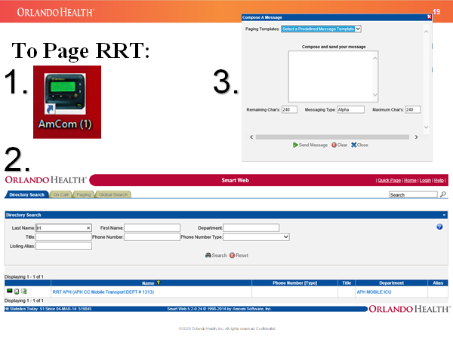
Rapid response
Be sure to stay at patient's bedside if a rapid response is called to be able to communicate concerns and information to the rapid response team. They can assist with further management and transfer to higher level of care

Slide 15
Code team
Discussion: How do you activate a code?
Discussion: Who responds to a code?

Slide 16
Code blue 45
Code buttons are on the wall in patient rooms and on the wall in the nurses station
** STAY WITH YOUR PATIENT
Code will be called overhead
Don’t orget to place backboard if you are doing chest compressions
For code blue 45 response the goal is less than 5 minutes. The code team consists of 2 PICU RNs, PSCU RN, RT, PICU resident, NP/Fellow/PICU attending if in house.

Slide 17
Case 2
It is 6pm, the day team has just left. The following tasks still need to be performed.
DISCUSSION: Rank in order of importance, and then share with group
Prescription for vitamin D for the 2 week old in 5002 so they can be discharged
Answer page from respiratory therapy about newly admitted 5 year old with severe asthma
Enter orders for clean out for 10 year old admitted for constipation
Write update note about the patient you saw who you did an abdominal check on earlier in your shift
Review the abdominal x-ray for feeding tube placement for the infant with failure to thrive
order morphine for the post-operative patient in 3004 in severe pain

Slide 18
General principles
Prioritize urgent orders such as pain medications, antibiotics/ urgent workup such as blood cultures, fluid boluses, respiratory treatments, etc.
Patient care comes first-- documentation is typically last priority. though it should still be performed in a timely fashion for communication purposes, when it is busy, take care of the patient evaluations and orders first and document/ work on sign out sheet once things have settled down

Slide 19
Case 3
You are the nighttime resident in block 1 and receive several calls from nurses that they are concerned that the sub-Intern is not returning pages.
DISCUSSION: What can you do to help the medical student prioritize and multitask?
do not make assumptions about the medical student’s behavior. Regard it as an opportunity to help them learn and improve
Discuss the issue with the sub intern and see what the problem is/ their thoughts on the issue strategies to improve
See if there are any technical issues with paging
Discuss organizational techniques (to do lists, discussing how to triage)
Discuss expectations for how quickly pages should be returned
Discuss that it can be helpful to set expectations (ex. Let family know it will take about 4 hours for the labs to come back, discuss with nurse it will take 30 minutes put in the simethicone order)
Check in with the student periodically

Slide 20
Take Home Points
Take proactive steps to aid you in triaging pages and phone calls at night.
Pay attention to the learners you are supervising and help them to appropriately triage their tasks.
Know who and what your resources are at night.
Remember that there is always back-up

Slide 21
References
Schmitt BD, Thompson DA. Triage Documentation: Setting a Best Practice. http://www.answerstat.com/articles/5/42.html, 2005.
Sharek P, et al. Effective of a Rapid Response Team on Hospital-wide Mortality and Code Rates Outside the ICU in a Children’s Hospital. JAMA, 298(19): 2267-2274, 2007.
Thompson T, Stanford K, Dick R, Graham J. Triage Assessment in Pediatric Emergency Departments: A National Survey. Ped Em Care, 26(8):544-548, 2010.

