Slide 1
Seizures
Inpatient Night Float curriculum
Please use PowerPoint presentation mode to facilitate discussion
Adapted from the National Pediatric Nighttime Curriculum: Anna lLin, MD (Lucile Packard children’s Hospital)
Updated 06-2020 MZ

Slide 2
Learning objectives
Discuss assessment and differential of patients with seizures
understand treatment for patients with seizures
discuss treatment of status epilepticus

Slide 3
Case 1: 2 am admit from the er
Billy is a 14 month old who presented with a new onset generalized tonic-clonic seizure.
DISCUSSION: What other information do you want to know?
Is it associated with a fever?
How long has it lasted?
Are there other symptoms?
Has he ever had a seizure before, if so, what type?
Is he developmentally normal?
Is there a family history of febrile seizures?

Slide 4
Case 1 continued
Billy had a fever of 102 upon arrival to the ER. He had a 5 minute seizure, he has never had a seizure before. He is developmentally normal and he has just been tugging on his ears but otherwise has been healthy with no other symptoms. No family history of seizures.
DISCUSSION:
1. What type of seizure is this?
Simple febrile seizure (<15 minutes, no focality, no recurrence in a 24 hour period)
2. What workup and management is indicated at this time?
No routine workup is needed for a simple febrile seizure
CBC with differential, electrolyte panels are not necessary for simple febrile seizures
Treat the underlying cause of fever (in this case, Acute Otitis Media should be treated)
Consider LP if patient is young (6-12 months) and unimmunized, ill appearing or with meningeal signs, or pretreated with antibiotics.
May consider further workup for complex febrile seizures

Slide 5
Case 2: 3 am transfer
Eleanor is a 12 year old with history of seizure disorder, being admitted for seizure. She has had 30 minutes of a generalized tonic-clonic seizure at the outside hospital. The ER doctor there wants to know what he should do?
DISCUSSION:
What are your initial steps in management?
First make sure to stabilize your ABCs (airway, breathing, circulation). Call for help. Obtain more history (medications, potential triggers)
Consider rapid workup for underlying etiologies:
CNS infection, hypoxemia, metabolic disease, electrolyte abnormalities, ingestions/toxins, stroke or traumatic brain injury
What is the first class of medication you should give?
Benzodiazepines

Slide 6
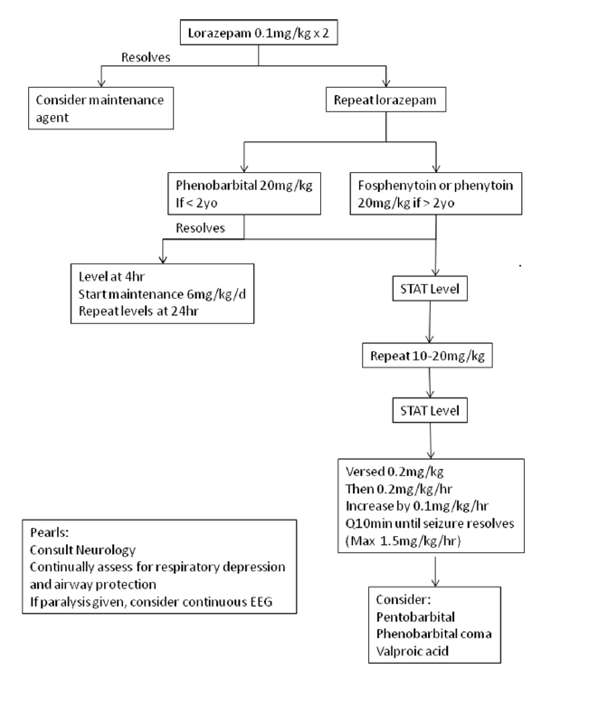
Management of status epilepticus (APH Algorithm)

Slide 7
Case 3: 4 am on the gen peds floor
Emily is a 12 year old admitted for G-tube revision with history of obstructive hydrocephalus and VP shunt. You are called by the nurse due to her having a generalized tonic-clonic seizure for the last 15 minutes.
DISCUSSION: What information in the history will be helpful to you as you start to intervene?
Has the patient had seizures before. When was her last seizure, and is this the same kind of seizure?
Does she take antiepileptics and if so, were there any doses missed due to surgery?
Have there been any other symptoms?
Fevers: concern for shunt infection
Vomiting: concern for shunt malfunction/ increased ICP
When was the patient’s shunt last evaluated/ has there been any recent revision?

Slide 8
Case 3 continued
DISCUSSION:
What would be concerning on physical exam for this patient for increased intracranial pressure?
Bradycardia, hypertension, and abnormal breathing (Cushing’s triad)
Pupillary response (fixed and dilated),sundowning, papilledema
Altered mental status, bulging fontanel, irritability, abnormal posturing
How can you initially manage this patient’s increased ICP?
Elevation of the head of the bed, mannitol or hypertonic saline, hyperventilation, prepare for intubation, contact neurosuregery, transfer to higher level of care

Slide 9
Seizure review
Definition of seizure: Abnormal electrical discharge in the brain causing a sudden sterotyped episode
Epilepsy: 2 or more unprovoked afebrile seizures
Status epilepticus:
*Arbitrary* definition of seizure activity lasting >30 minutes OR
Multiple episodes with failure to regain consciousness between episodes.
Seizures greater than 3-5 minutes should be intervened upon and have high risk of lasting 30 minutes of more.
20% mortality rate with status epilepticus

Slide 10
Types of seizures
Generalized:
Bilateral, involves both hemispheres, no awareness.
Can be Convulsive versus nonconvulsive (ex. Absence seizures)
Can be secondary/ provoked (ex. Secondary to meningitis, trauma, toxins)
Secondary generalized seizures begin as a focal seizure then generalizes
Partial
Can be motor-focal motor, running eyes, head or trunk, vocalization or arrest of speech), sensory, (paresthesias, olfactory or gustatory), autonomic (sweating, piloerection), psychic (cognitive, hallucinations)
Simple Partial (consciousness maintained)
Complex Partial (leads to loss of consciousness)

Slide 11
antiepileptics
Benzodiazepines:
Lorazepam: 0.05mg/kg/dose to 0.1mg/kg/dose IV. Max dose 4mg. Onset of action 2 minutes. Longer acting, less respiratory depression
Diazepam: quick onset 10-20 seconds, rectal formulation available (dose varies by age- max of 10mg rectal). Not first line due to lower efficacy and increased respiratory depression. Option for patients without IV access.
Midazolam (ICU): Onset of action 1 minute. Short half life.
Phenobarbital: prolonged sedation, respiratory depression, and hypotension
Fosphenytoin: can cause cardiac arrythmias
Other medications such as levetiracetam and topiramate can be used, but limited data.

Slide 12
suggested reading/ References
AAP Powerpoint: Seizures Overview
https://www.aap.org/en-us/Documents/echo_session%201_seizures_overview.pdf
Pediatric Seizures (Pediatrics in Review 2013)
https://pedsinreview.aappublications.org/content/34/8/333#sec-8
Febrile Seizures: Guideline for the Neurodiagnostic Evaluation of a Child with a Simple Febrile Seizure 2011 https://pediatrics.aappublications.org/content/127/2/389?ijkey=168f23480e00ef7e5dbaaafc56cd03e90b68bab6&keytype2=tf_ipsecsha
*This presentation was adapted from the APPD National Pediatric Nighttime Curriculum Written by Anna Lin, MD

