Slide 1
Communication on Nights
Adapted from the National Pediatric Nighttime Curriculum: Jennifer Maniscalco, MD, MPH (Children’s Hospital Los Angeles)

Slide 2
Objectives
Discuss elements of physician-parent-child communication
Review the patient and provider roles in difficult relationships
Describe a framework to improve communication with patients and overcome challenging interactions

Slide 3
Case One
Rania is a 5 year old girl with lobar pneumonia and effusion, hospitalized with respiratory distress and hypoxia. You are called to her bedside at 1 am because of worsening respiratory status. On exam, she appears ill and uncomfortable. She is febrile, tachypneic, with diminished breath sounds on the right base and both subcostal and intercostal retractions. Her parents, whom you have never met, are at the bedside and appear worried.
DISCUSSION: What are the challenges of communicating with the patient and parents in this situation?
High acuity situation
First encounter with the family and patient
You have limited information about the patient and less time with patients due to increased patient load on nights
Likely have multiple interruptions
Patient and family likely to be tired

Slide 4
Case One Continued
DISCUSSION: How would you approach the conversation with the parents and patient?
Introduce yourself and your role, build rapport, gather data, review clinical course, give information, provide them with opportunities to ask questions and relay their concerns, validate their feelings and discuss course of action
This Photo by Unknown Author is licensed under CC BY-NC-ND

Slide 5
Physician-Parent-Child Communication
Informativeness: explaining the situation in an understandable manner
Interpersonal sensitivity: address the emotional need to be heard
Validating feelings: “I can see that you are worried, what are your specific concerns?”
Maintain eye contact, use appropriate gestures, active listening
Partnership building: direct communication to the child, consider cultural preferences
Notes:
Teacher’s Guide:
There are three basic components to physician-parent-child communication, listed here. “informativeness” refers to the quantity and quality of health information provided. It directly addresses the cognitive needs of the patient and/or parent, and forms the foundation for the physician’s task-related behavior. The physician may say, “She may have respiratory distress because her effusion has worsened, so I am going to get a chest x-ray.”
Interpersonal sensitivity and partnership building address the affective needs of the patient and/or parent – that is, the emotional need to feel heard and be understood. These two components inform the physician’s relational behavior – showing concern and respect. The physician may say, “I can see that you are worried. What worries you the most? What ideas do you have to make R.D. feel better?” Some nonverbal ways to show concern and respect include maintaining eye contact, using appropriate gestures, and using active listening skills.
The literature overwhelmingly supports direct communication with the child, provided that the communication is done in a developmentally appropriate manner, taking into account the parent-child relationship and the family’s cultural values.

Slide 6
Case Two
You finally have a moment to eat dinner at 2 am during your busy shift. Your pager alarms and the following message appears: “Patient J.S.’s mother is here. She is upset and asking to speak to the doctor. Please come ASAP.”
You groan in response. Mrs. S has become notorious on your team, a so-called “difficult parent,” because she is always upset and demanding of the provider’s time. You have been dreading receiving this page. You decide to eat your dinner quickly, and then go to the bedside.
DISCUSSION: What characteristics of the parent and provider contribute negatively to this situation?
Having a pre-conceived notion/ bringing negative energy to the situation, having avoidant behaviors. Parent being upset before you have come to speak to them
DISCUSSION: What approach would you use when talking to Mrs. S?
Prepare yourself for the interaction, approach it with calmness, review patient case and any potential concerns and how you will maintain professional demeanor when interacting with the family

Slide 7
Case Two- Continued
You review your sign-out: J.S. is a 4 month old with bronchiolitis. Parents were not present or reachable by phone during day. You learn from the nurse that Mrs. S is upset because J.S. was placed on oxygen and she was not notified.
When you walk into the room, Mrs. S has her arms folded across her chest. You introduce yourself, and she responds by complaining about her son’s care and how no one is talking to her. You listen for a minute or two, and end up having to interrupt her to get a word in. You mention that your colleague called during the day but no one answered. Mrs. Smith just gets more upset, saying that there was no message and no one is keeping her informed.
What is the goal of the provider’s interaction with Mrs. S?
Alleviate concerns, provide education, establish good communication, ensure family is updated and understands patient condition and expectation
How is this goal best accomplished?
Active listening, validation of concerns

Slide 8
What is a difficult patient?
One who…
Raises negative feelings within the clinician
Causes the clinician to experience self-doubt (threatens clinician’s competence or control)
Has beliefs, values, or characteristics that differ from those of the clinician
Does not assume the role expected by the health care professional
Places extra demands on the clinician
Emotional/ expresses emotions
A difficult patient is one who impedes the clinician’s ability to establish a therapeutic relationship, but…
Notes:
Teacher’s Guide:
Common characteristics and circumstance of patients perceived to be difficult by providers:
Emotional and expressive of emotions
Certain personality features or disorders
Personal characteristics viewed negatively by provider (different moral or ethical view points, non-English speakers, disheveled or unkempt appearance)
Specific clinical problems
Places extra demands or stresses on the clinician

Slide 9
… It Takes Two!
The difficult patient must be viewed in context of the clinician and the clinician-patient relationship.
Physicians:
Receive biomedical training, focused on identification and treatment of the disease
May not receive adequate psychosocial training, focused on communication and relationship-building
Often have negative emotional responses to patients that are not fully recognized and lead to unconstructive behaviors
For example, avoiding speaking to the family, keeping interactions unusually brief leading to more miscommunication and resentment
Awareness of these responses is important to be able to improve communication skills
Notes:
Teacher’s Guide:
Literature supports notion that most learners can be taught awareness of negative responses and harmful behaviors. Communication skills training can improve an individual’s ability to communicate in difficult situations.
Pay special attention to the final point -- physicians often have negative emotional responses to patients that are not fully recognized and lead to unconstructive behaviors. Some examples are listed below. Have the learners reflect on these patterns. Do they recognize these behaviors in themselves or others?
If the clinician feels threatened → leads to over control of the interview or situation
If the clinician has discomfort with psychological issues → leads to avoidance
If the clinician dislikes the patient → leads to superficial behavior

Slide 10
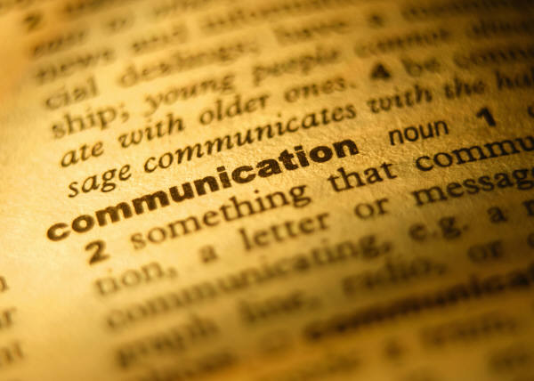
The most common element of an adversarial clinician-patient relationship is failed communication.
This Photo by Unknown Author is licensed under CC BY-SA

Slide 11
NURS Mnemonic
Goal: Elicit the patient’s emotions and address them.
Naming: recognition of emotion
“You are angry.” or “That was sad for you.”
Understanding: acceptance and validation of emotion
“I can only imagine that must have been frustrating for you.”
Respecting: respect their experience, praise their efforts
“You’ve been juggling a lot.” or “You did a great job recognizing that he was getting more sick and bringing him to be evaluated.”
Supporting: express support, create partnership
“Let’s work together to come up with a better way to address this.”
Notes:
Teacher’s Guide:
The NURS mnemonic can provide a framework for approaching communication with an angry or difficult parent.

Slide 12
Case Two- Revisited
Using the NURS mnemonic, craft a response to Mrs. S.
“Mrs. S, I can see that you are upset and I can understand why. It must be difficult to arrive at the hospital and learn that your son is now requiring oxygen. You’ve been juggling a lot, with having to go to take care of your other children and be here at the hospital with J.S. What questions can I answer for you now?
I am sorry that we were not able to communicate better during the day. What would be the best way to make sure this type of thing doesn’t happen again?”
Notes:
Teacher’s Guide
Ask the learners to think back to Case Two. Ask them to use the NURS mnemonic to generate possible responses to Mrs. S.
One example of a response, using the NURS mnemonic, is given.

Slide 13
Other tips for improving communication
Be patient-centered
Use open-ended questions and active listening
Echo and summarize what the patient says
Demonstrate empathy
Be self-aware
Incorporate knowledge about the patient’s personality
Acknowledge the problem
Use problem solving skills and participate in the solution
Set appropriate boundaries
Apologize when appropriate
This Photo by Unknown Author is licensed under CC BY-NC-ND
Notes:
Teacher’s Guide:
Here are some other tips for improving communication between providers and patients or parents.
Examples of incorporating knowledge about the patient’s personality:
With an obsessive patient, avoid battles over control. Provide information and engage intellectual discussion, don’t push for emotional response initially.
With a dependent patient, meet some of the special needs while setting some boundaries, and slowly facilitate more independence.

Slide 14
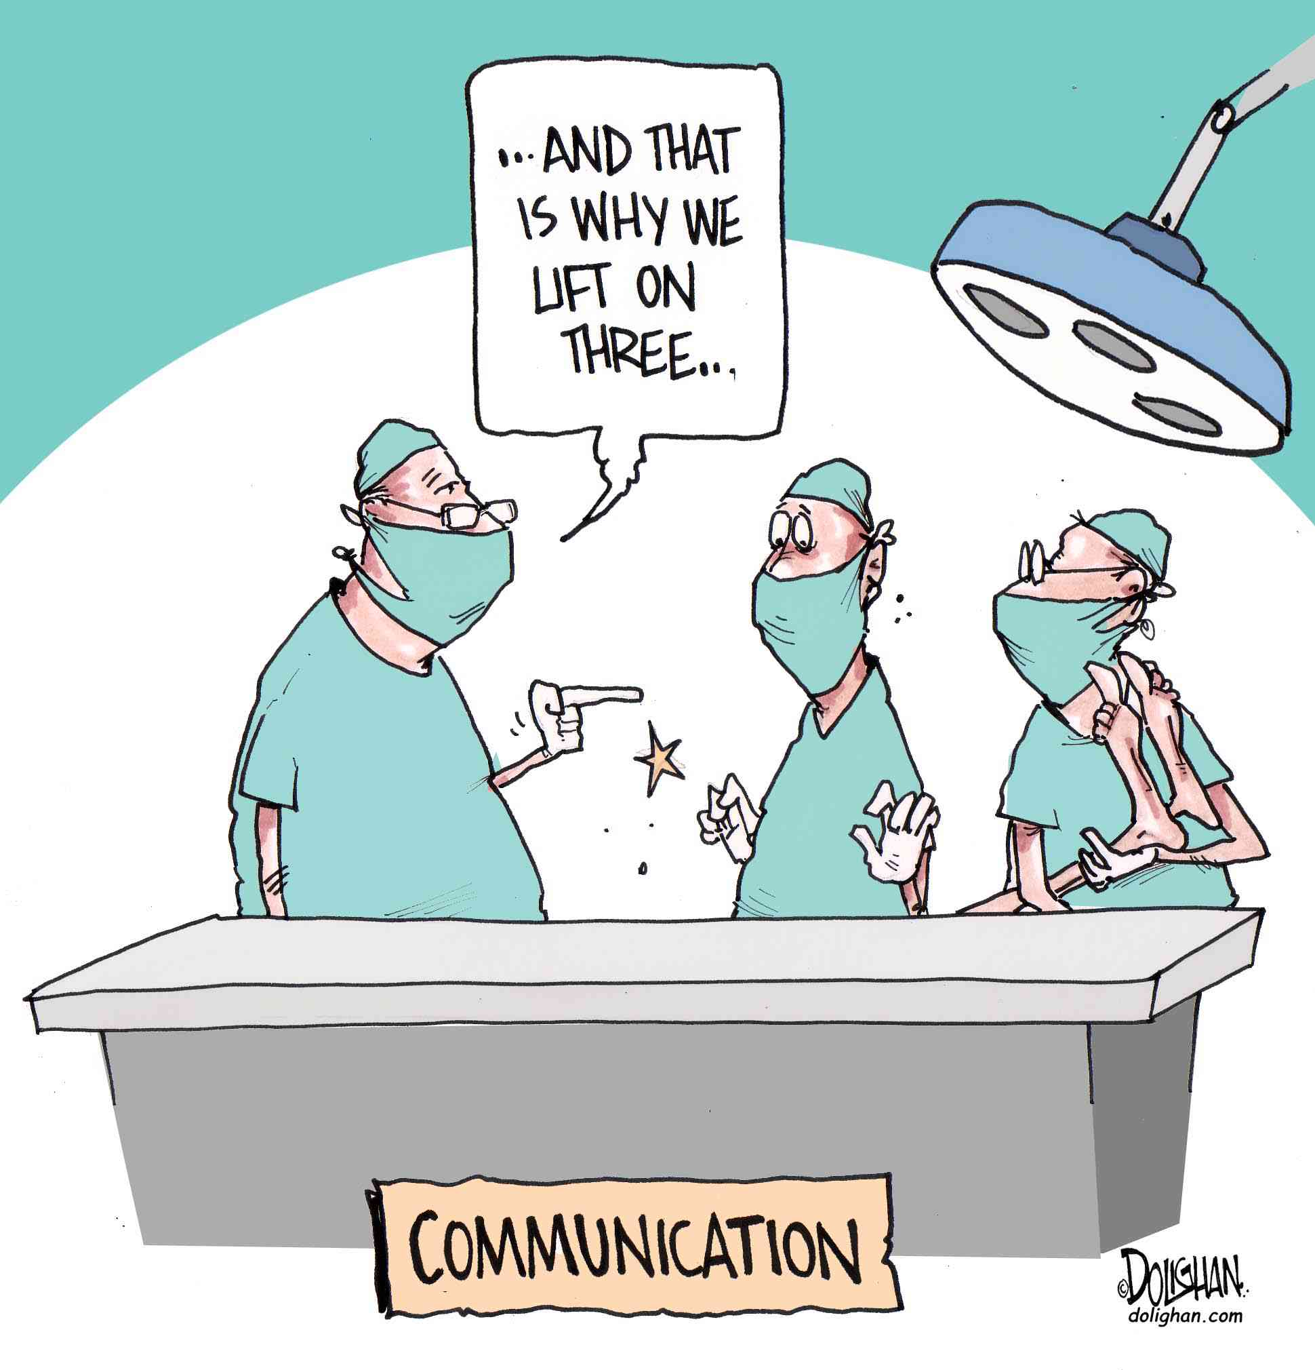
Communication
Team should communicate with families throughout the day and update them about results, new treatments, course of care
Having a good sign out with minimal distractions, that is thorough but concise, and that anticipates patient complications with appropriate contingency plans is important to providing contiguous clinical care
This Photo by Unknown Author is licensed under CC BY-ND

Slide 15
Take Home Points
The most common element of an adversarial clinician-patient relationship is failed communication.
Both the patient and the clinician contribute to failed communication. Clinicians must recognize and change their negative responses and harmful behaviors in order to improve communication.
Being patient-centered, using active listening skills, and acknowledging and respecting emotions can improve communication with patients and parents.

Slide 16
References
Fortin AH, Dwamena FC, and Smith RC; The Difficult Patient; UpToDate; http://www.uptodate.com/contents/topic.do?topicKey=PC/2764; updated March 24, 2010; accessed February 22, 2011.
Levetown M and the Committee on Bioethics. Communicating with Children and Families: From Everyday Interactions to Skill in Conveying Distressing Information. Pediatrics 2008; 121: e1441-e1460.
Strous RD, Ulman A, and Kolter M. The Hateful Patient Revisited: Relevance for 21st Century Medicine. Eur J Intern Med 2006; 17: 387-93.
Su Rehman, DW Cope, RM Frankel, and S Wali; Expanding Our Skills for Dealing With Difficult Patient Workshop WD04; Society of General Internal Medicine; http://www.sgim.org/userfiles/file/AMHandouts/AM06/handouts/WD03.pdf; April 28, 2006; accessed February 22, 2011.

